Slide 1
The Pumping Lemma for
Context-Free Languages

Slide 2
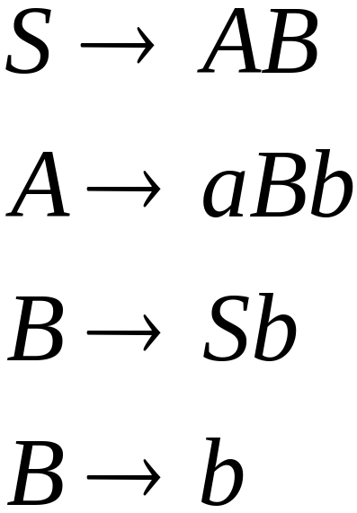
Take an (infinite) context-free language
Generates an infinite number
of different strings
Example:
Courtesy Costas Busch - RPI

Slide 3

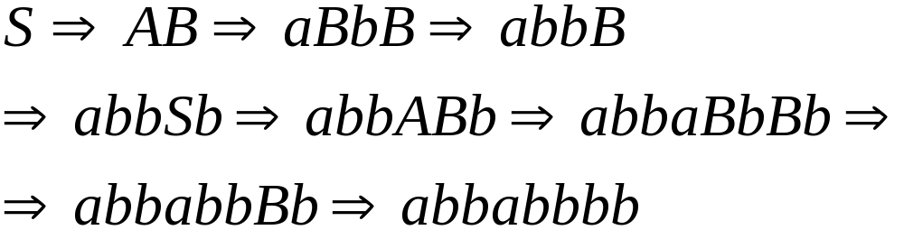
In a derivation of a long string,
variables are repeated
A derivation:
Courtesy Costas Busch - RPI

Slide 4






Derivation tree
string
Courtesy Costas Busch - RPI

Slide 5
Derivation tree
string
repeated
Courtesy Costas Busch - RPI

Slide 6
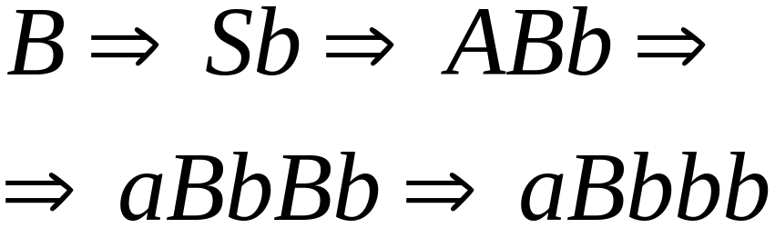
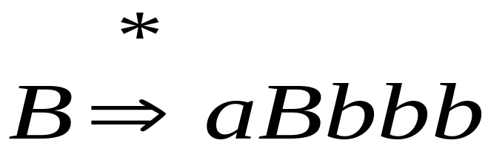

Courtesy Costas Busch - RPI

Slide 7
Repeated Part
Courtesy Costas Busch - RPI

Slide 8

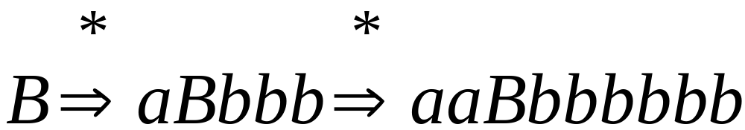
Another possible
derivation from
Courtesy Costas Busch - RPI

Slide 9
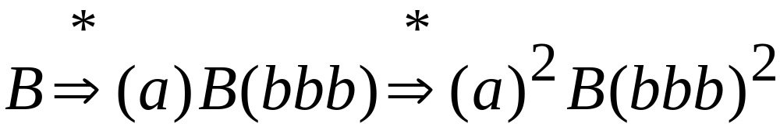
Courtesy Costas Busch - RPI

Slide 10

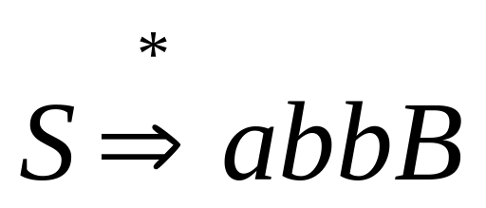
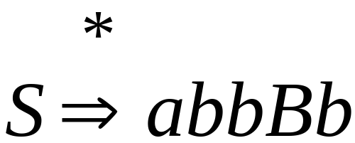
A Derivation from
Courtesy Costas Busch - RPI

Slide 11
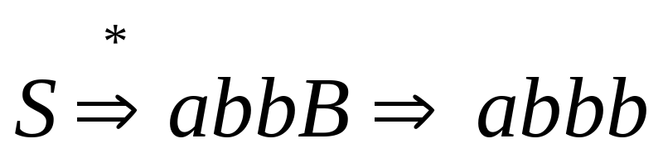
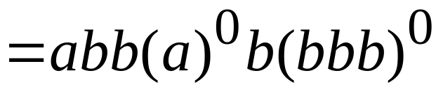
Courtesy Costas Busch - RPI

Slide 12
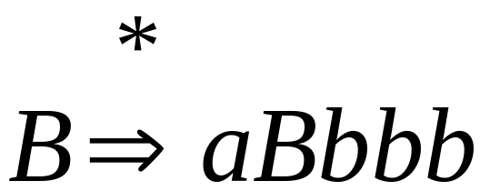
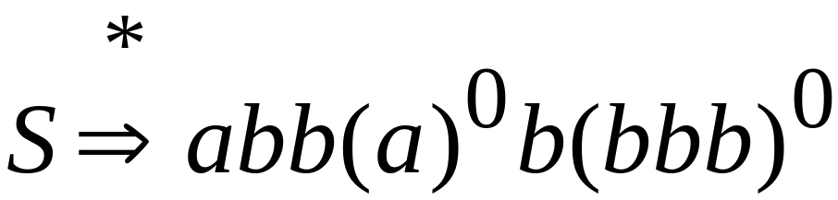
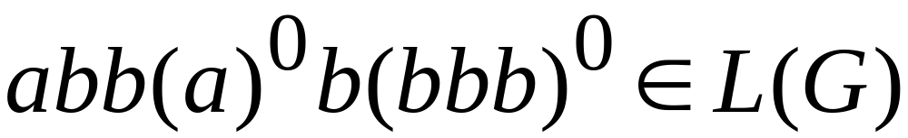
Courtesy Costas Busch - RPI

Slide 13
A Derivation from
Courtesy Costas Busch - RPI

Slide 14
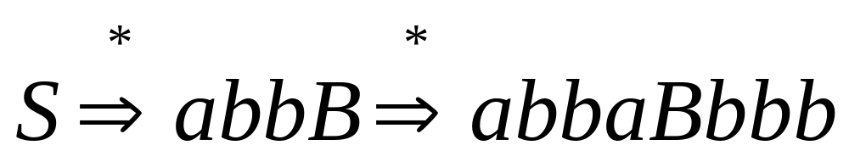
Courtesy Costas Busch - RPI

Slide 15
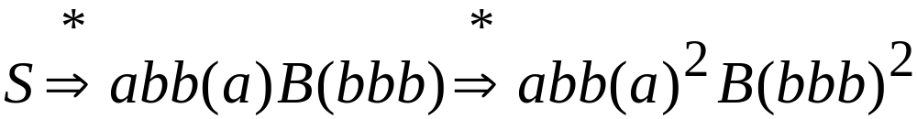
Courtesy Costas Busch - RPI

Slide 16
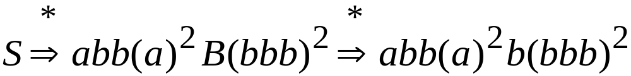
Courtesy Costas Busch - RPI

Slide 17
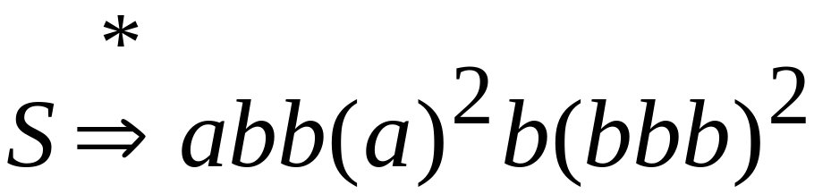
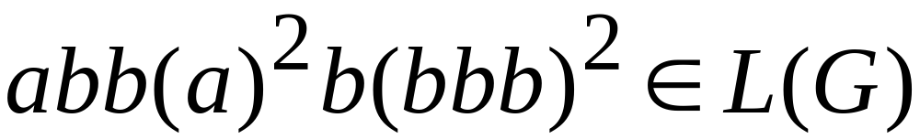
Courtesy Costas Busch - RPI

Slide 18
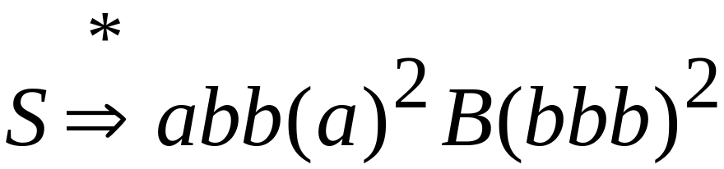
A Derivation from
Courtesy Costas Busch - RPI

Slide 19
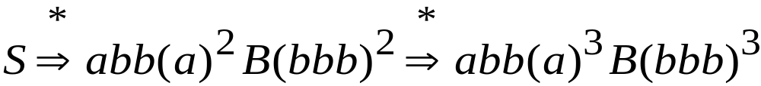
Courtesy Costas Busch - RPI

Slide 20
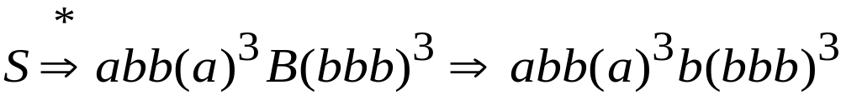
Courtesy Costas Busch - RPI

Slide 21
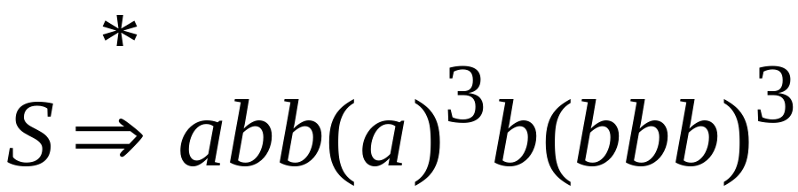
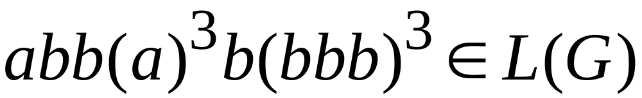
Courtesy Costas Busch - RPI

Slide 22
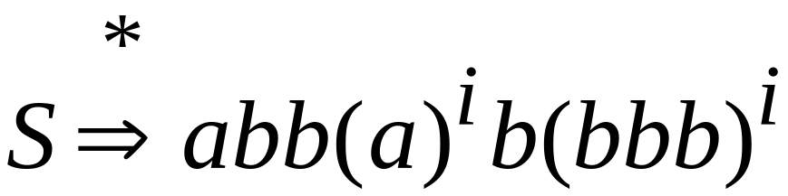
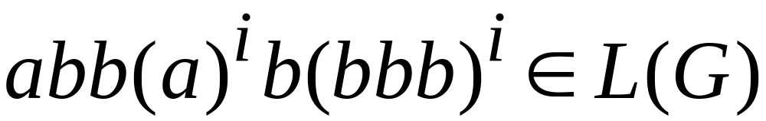
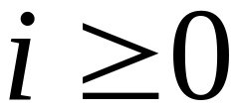
In General:
Courtesy Costas Busch - RPI

Slide 23


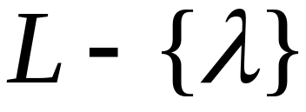

Consider now an infinite
context-free language
Let be the grammar of
Take so that it has no unit-productions
no -productions
Courtesy Costas Busch - RPI

Slide 24

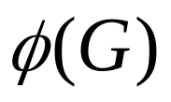
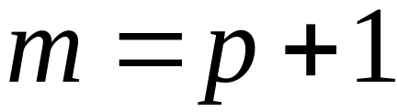

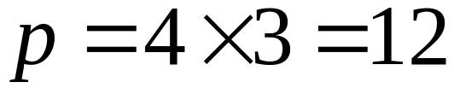
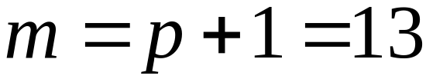
Let
=
(Number of productions) x
(Largest right side of a production)
Let
Example :
Courtesy Costas Busch - RPI

Slide 25

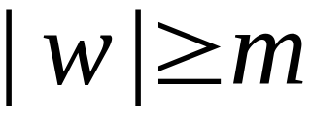

Take a string
with length
We will show:
in the derivation of
a variable of is repeated
Courtesy Costas Busch - RPI

Slide 26
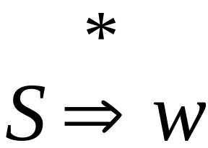
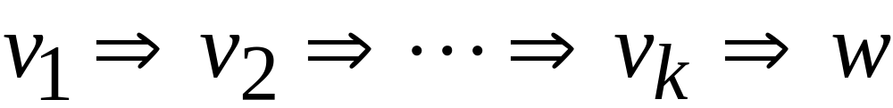
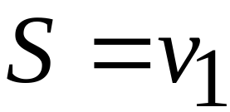
Courtesy Costas Busch - RPI

Slide 27
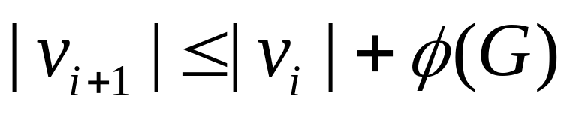
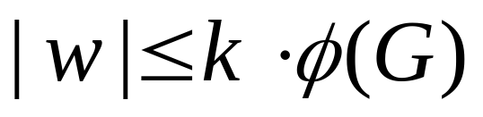
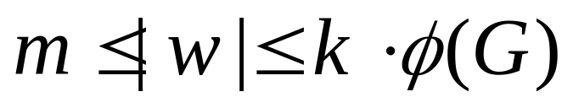
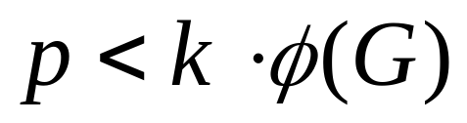
maximum right hand side
of any production
Courtesy Costas Busch - RPI

Slide 28

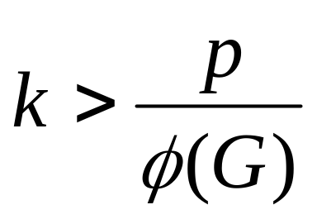
Number of productions
in grammar
Courtesy Costas Busch - RPI

Slide 29

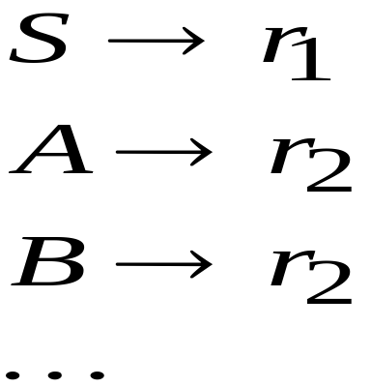
Number of productions
in grammar
Some production must be repeated
Repeated
variable
Courtesy Costas Busch - RPI

Slide 30
Derivation of string
Some variable is repeated
Courtesy Costas Busch - RPI

Slide 31







Derivation tree of string
Last repeated variable
repeated
Strings of terminals
Courtesy Costas Busch - RPI

Slide 32
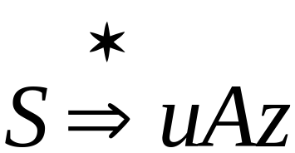
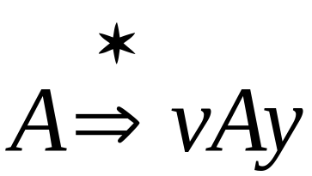
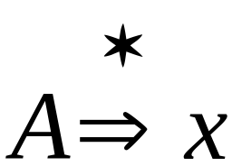
Possible
derivations:
Courtesy Costas Busch - RPI

Slide 33
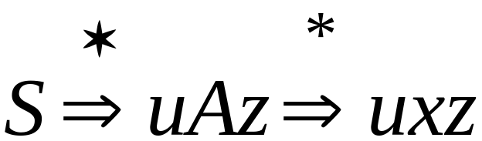
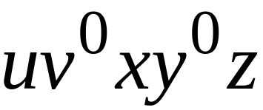
We know:
This string is also generated:
Courtesy Costas Busch - RPI

Slide 34
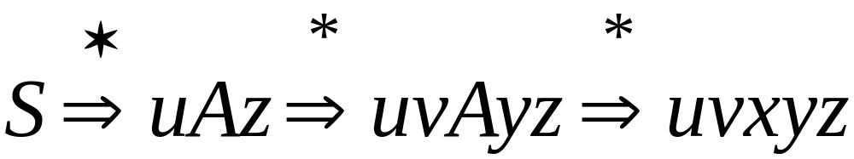
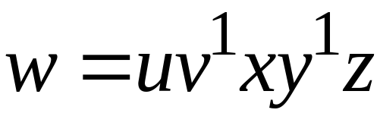
We know:
This string is also generated:
The original
Courtesy Costas Busch - RPI

Slide 35
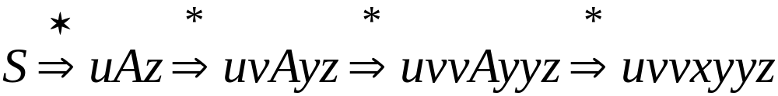
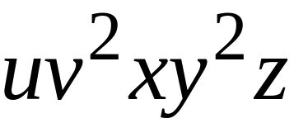
We know:
This string is also generated:
Courtesy Costas Busch - RPI

Slide 36


We know:
This string is also generated:
Courtesy Costas Busch - RPI

Slide 37



We know:
This string is also generated:
Courtesy Costas Busch - RPI

Slide 38

Therefore, any string of the form
is generated by the grammar
Courtesy Costas Busch - RPI

Slide 39




Therefore,
knowing that
we also know that
Courtesy Costas Busch - RPI

Slide 40





Observation:
Since is the last repeated variable
Courtesy Costas Busch - RPI

Slide 41


Observation:
Since there are no unit or -productions
Courtesy Costas Busch - RPI

Slide 42





The Pumping Lemma:
For infinite context-free language
there exists an integer such that
for any string
we can write
with lengths
and it must be:
Courtesy Costas Busch - RPI

Slide 43

Courtesy Costas Busch - RPI

Slide 44

Courtesy Costas Busch - RPI

Slide 45
Reminders
Choosing m :
The thing to remember about the pumping length m is that you don’t get to choose it!
The pumping lemma itself “supplies” this value to you. So you cannot make any assumption about what the value of m is, you simply must use it as a fixed value over which you have no control.
Courtesy Costas Busch - RPI

Slide 46
Reminders
Choosing w :
A good place to start is with a string that incorporates the pumping length m in it somehow,
e.g. a^{m}b^{m} if your alphabet is {a, b}.
The right string can reduce the number of different partitions you must consider.
As you work through more and more examples of these types of proofs, you gather insight into the types of strings that will work best. So the best way to get better at choosing w is to read examples and, even better, to work problems.
Courtesy Costas Busch - RPI

Slide 47
Reminders
Choosing the partition of w :
The thing to remember about the partition of w into its parts u, v, x, y & z is, again, that
you don’t get to choose it!
The partition is, in some sense, chosen for you. But it is never explicitly given to you (the way you can think of the pumping length as being given to you), so you must consider all possible partitions.
Remember, that for each partition of w, you must show that for some integer i, the string uv^{i}xy^{i}z is not in L.
Courtesy Costas Busch - RPI

Slide 48
Reminders
Choosing i :
You do get to choose this, and you’re given quite a bit of freedom. You may pick i so that it is any integer greater than 1, or even 0.
It doesn’t make sense to select i = 1, since that would describe w, a string which you already know to be in L.)
You may even choose i differently in different cases of your proof. This is useful, for example, if some cases work only if you “pump down” to i = 0, while others work only if you “pump up” to i = 2 or i = 3.
Courtesy Costas Busch - RPI

Slide 49
Cautions
Be sure that the w you choose is actually in the language L you are trying to prove something about! If not, the pumping lemma doesn’t guarantee anything about whether pumping that w should give strings in L.
Also, be sure that your string w is long enough: it must have length at least m.
In the pumping lemma for context-free languages, when you pump a particular string, note that the i describing the number of repetitions of v must be the same i describing the number of repetitions of y.
So it doesn’t help your proof to show a “pumped” string uv⁰xy²z which is not in L, since 0 ≠ 2.
Courtesy Costas Busch - RPI

